Slide 1
Calcium-Cholesterol Project

Slide 2
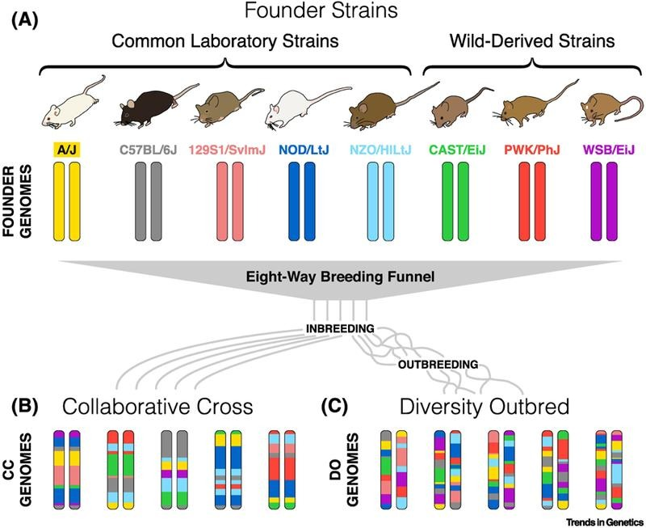
Diversity Outbred Mice
Saul MC, Philip VM, Reinholdt LG; Center for Systems Neurogenetics of Addiction; Chesler EJ. High-Diversity Mouse Populations for Complex Traits. Trends Genet. 2019 Jul;35(7):501-514. doi: 10.1016/j.tig.2019.04.003.

Slide 3
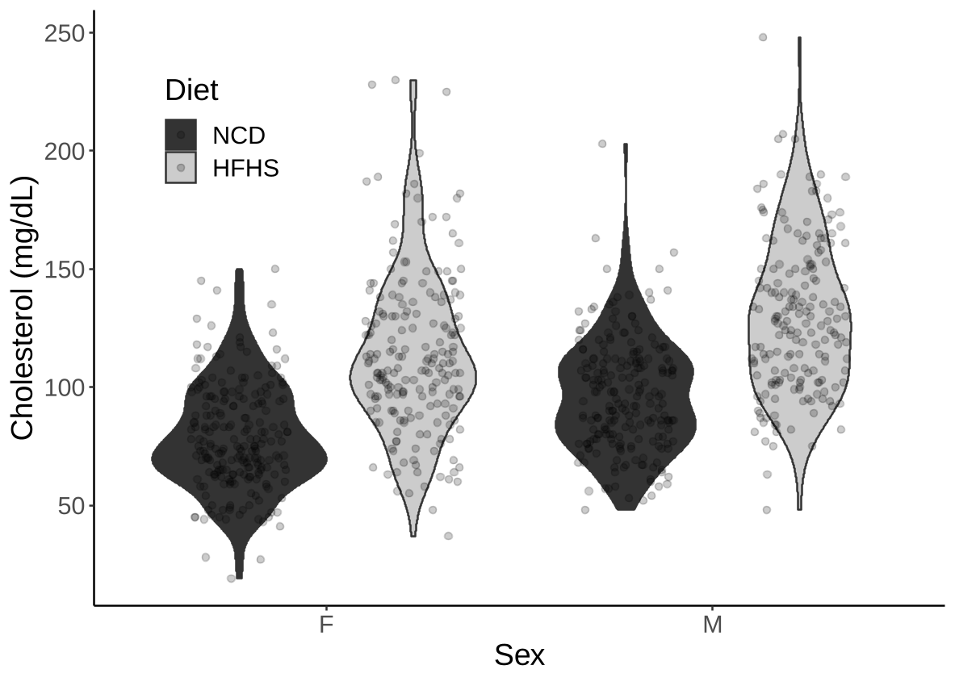
Effects of Diet and Sex on Cholesterol Levels

Slide 4
Cholesterol and Triglycerides Levels Correlate

Slide 5
a priori predictors of high cholesterol in mice
Mean cholesterol (mg/dL)
Number of mice

Slide 6
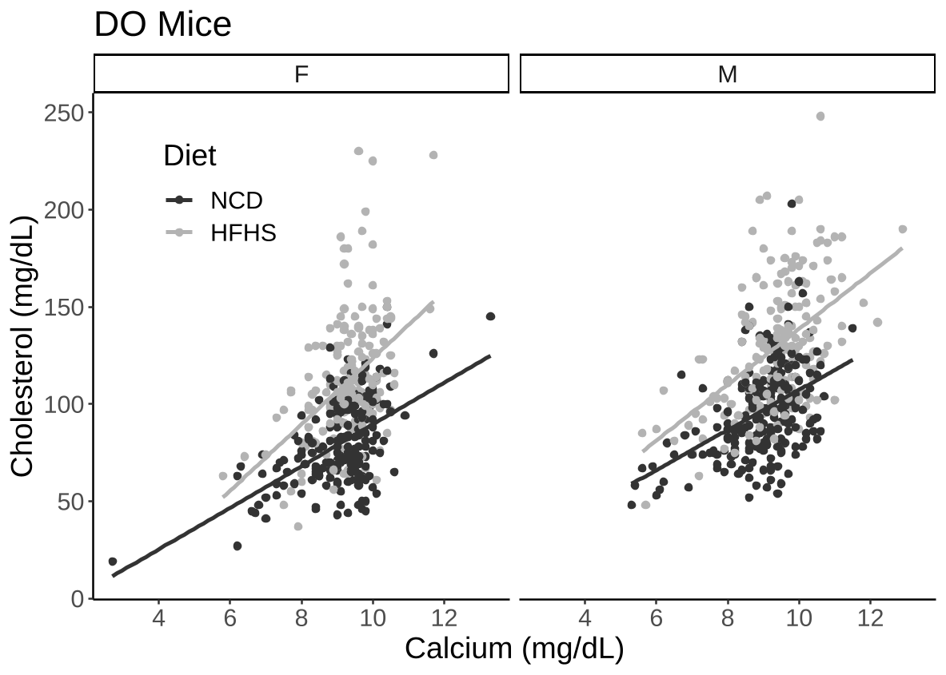
Calcium is Associated with Cholesterol
Explains 38-41% of the variance
Independent of diet and sex

Slide 7
This positive association is also found in humans
Correlation from human studies

Slide 8
Follow-up Questions
What is the direction of this relationship
Calcium -> Cholesterol
Cholesterol -> Calcium
Some third factor regulates both
What is the relevance of this relationship

Slide 9
Assessing Directionality (Ongoing)
Mice with elevated cholesterol (WT and Ldlr ^{-/-} knockout mice)
Effects on cholesterol
Effects on calcium
Bone density, bone fragility
Mice with elevated calcium (PTH implanted)
Effects on calcium
Effects on cholesterol
Mice with elevations in both (PTH + Ldlr ^{-/-})

Slide 10
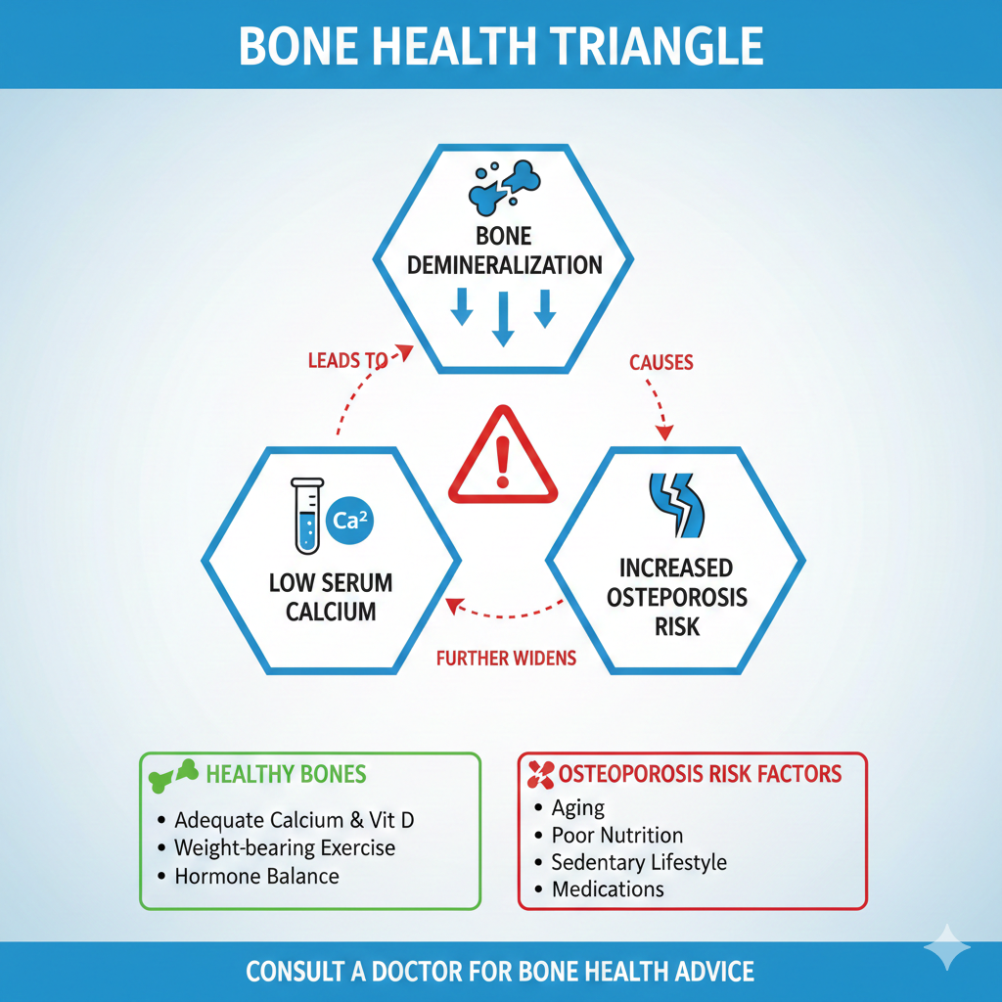
Bone demineralization and osteoporosis
Age related loss of bone density
10M Americans (8M are women)
Generated by Google Gemini

Slide 11
Cholesterol and Bone Demineralization are Co-morbid
LDL-C is associated with fracture risk (Ghorabi et al., 2019)
Inverse relationship between cardiovascular disease and bone mineral density (Iseri et al., 2020; Yang & Huang, 2023)
Statins causes a 18-19% decline in fracture risk (An et al., 2017) and a 3.2% increase in BMD (Zhao et al., 2013, Cheungsaman et. al., 2010, Wang et. al., 2016)

Slide 12
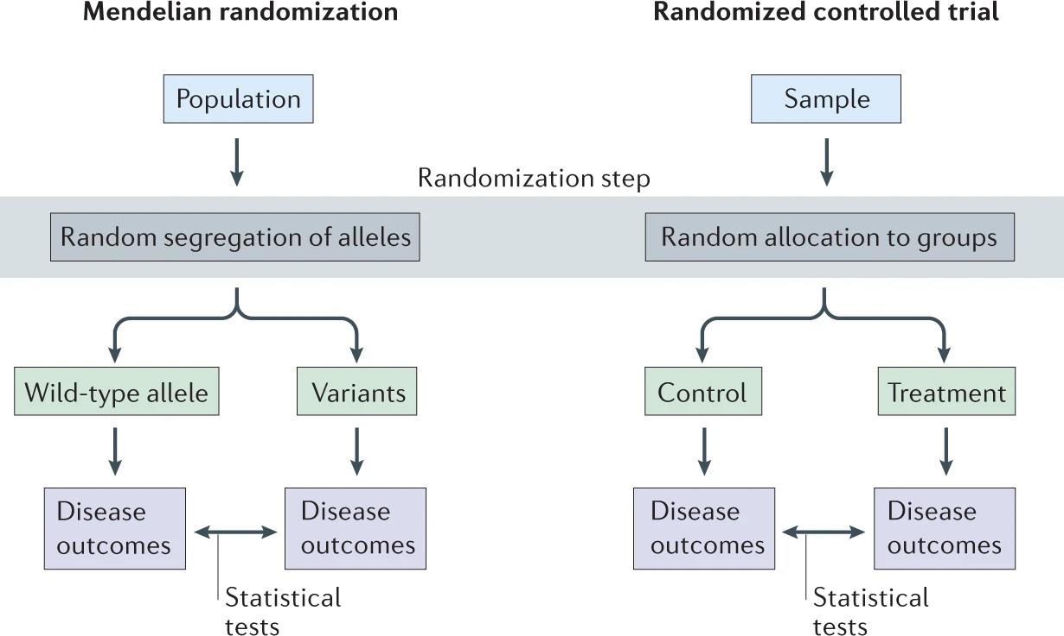
Mendelian Randomization

Slide 13
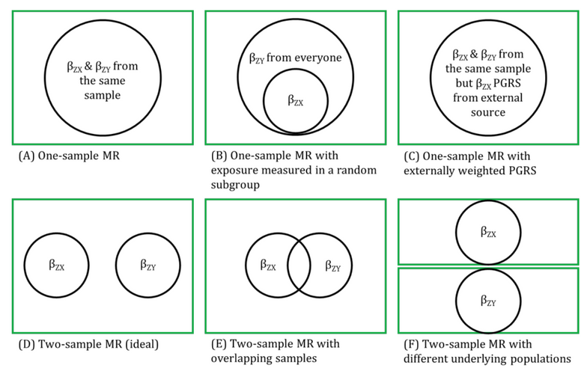
Two Sample Mendelian Randomization
Ideal
https://mr-dictionary.mrcieu.ac.uk/term/non-overlapping/

Slide 14
Steps to a 2-step MR
Identify an exposure dataset
SNPs that associate with the exposure
Identify an outcome dataset
SNPs that associate with the outcome
Outcome should be similar ancestry but different participants
Harmonize SNPs
Clump SNPs in linkage dis-equillibruim
Must be common (>1%)
Must exist in both datasets
Must associate more strongly with exposure than the outcome

Slide 15
Validation of Method
Exposure
Calcium SNPs (UKBB)
Outcome
Calcium SNPs (MGI/BioVU)
Results
Slope = 0.54 +/- 0.02
SD for calcium is ~0.5
1SD increase in genetically predicted calcium is associated with 1SD increase in calcium
P<0.0001

Slide 16
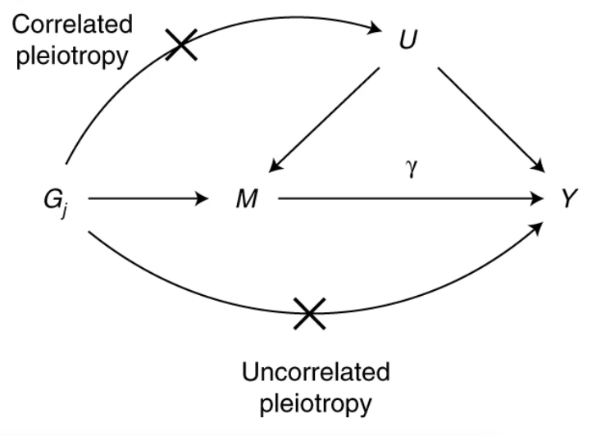
Some Caveats with the Methods Used
Weak instrument bias
Heterogeneity
Horizontal Pleiotropy
Correlated
Uncorrelated
Association Driven by a Small Number of Influential SNPs
Morrison, Jean, Nicholas Knoblauch, Joseph H. Marcus, Matthew Stephens, and Xin He. “Mendelian Randomization Accounting for Correlated and Uncorrelated Pleiotropic Effects Using Genome-Wide Summary Statistics.” Nature Genetics 52, no. 7 (2020): 740–47. https://doi.org/10.1038/s41588-020-0631-4.

Slide 17
Statistical Methods
Primary method
Inverse Variance Weighted Multiplicative Random Effects (IVW-MRE)
Alternate methods
MR-IVW Fixed Effects (SNPs have same error)
MR-RAPS (SNPs have weak effect)
Weighted median (assumes only half SNPs are valid)
Weighted mode (plurality of SNPs have same valid effect)
MR-Egger (assumes uncorrelated pleiotropy)
MR-PRESSO (models for uncorrelated horizontal pleiotropy)
MR-CAUSE (models both correlated and uncorrelated pleiotropy)
Notes:
FE – all variants have the same effects (variance is sampling error) MRE – variants have nonidentical errors

Slide 18
Series of Tests for Those Assumptions
Calcium-Calcium Positive Control
Instruments F>10
If not use MR-RAPS
Significant heterogeneity
Used IVW-MRE not FE
Global tests (detects outliers)
If significant – outliers detected
Perform a distortion test
Adjusts for outliers (MR-PRESSO)

Slide 19
Models Testing the Association Between Cholesterol and Calcium

Slide 20
SNP Level Associations for TC-Calcium
Calcium
Genetically Encoded Cholesterol

Slide 21
Validation Tests for Chol -> Calcium

Slide 22
Overall Results

Slide 23
Possible Biological Mechanism
H1: Cholesterol -> High Vitamin D → More Ca
H2: Cholesterol -> Bone demineralization -> More Ca
Exposure
Total Cholesterol SNPS from UK BioBanl
Outcomes
Vitamin D levels (MGI-BioVU LabWAS)
Bone mineral density (GEFOS)
Notes:
GEnetic Factors for OSteoporosis Consortium

Slide 24
Results
Bayesian Inference
Probability of hypothesis true
Vit D True = 2.5%
BMD True = 88.8%
Both True = 8.5%
Neither True = 0.2%

Slide 25
Relevance of co-morbid increases
Individuals with osteoporosis have a > 4 fold increased risk of myocardial infarction, and a > 3.5x increased risk of stroke (Renjithlal et al., 2022).
Elevated serum calcium was associated with increased risk of both myocardial infarction and coronary artery disease (Jorde et. al., 1999, Foley et. al., 2008) .
MR shows genetically encoded calcium increases risk of CAD or myocardial infarction by 24-25% per SD (Larssen et. al., 2017).

Slide 26
Design
Mice
Models
WT
PTH
LDR knockout
PTH + LDLR knockout
Outcomes
Atherosclerotic plaques
Memory?
Humans
Longitudinal analysis
Exposures
Cholesterol/LDL-C
Serum calcium
Outcomes
MACE
Covariates
Age
BMI
Diabetes
SES

